Slide 1




A Clinical Data Warehouse Ecosystem to Support Research & QAQI
David E. Bard, PhD¹
William H. Beasley, PhD¹
Zsolt Nagykaldi, PhD²
¹Department of Pediatrics
²Department of Family and Preventive Medicine
University of Oklahoma Health Sciences Center

Slide 2
Objectives
Define and describe clinical data warehouses
Provide examples of data warehouse uses in medicine and public health
Describe the connection between data warehousing and Big Data
Challenges of building a clinical data warehouse (legal, architectural, procedural)
Limitations of warehouse projects
Birth and development of an OUHSC CDW
Brief demonstration of two initial pilot projects
Future directions for the OUHSC CDW

Slide 3
What is a Clinical Data Warehouse?
A data warehouse is a repository of historical data organized for reporting and analysis. It facilitates data access by having data from many sources in one place, linked together, and easily searchable.
Common CDW Characteristics
A database containing data from multiple sources
Data extracted from the databases of clinical software packages
A database containing data related to each other with some unique identifier
A database that is only as good as the data entered
Slide courtesy of BUMC Rozen & Saitz
http://www.bumc.bu.edu/crro/files/2010/01/Rosen-4-11-07.pdf

Slide 4
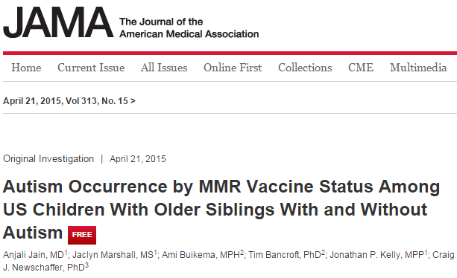
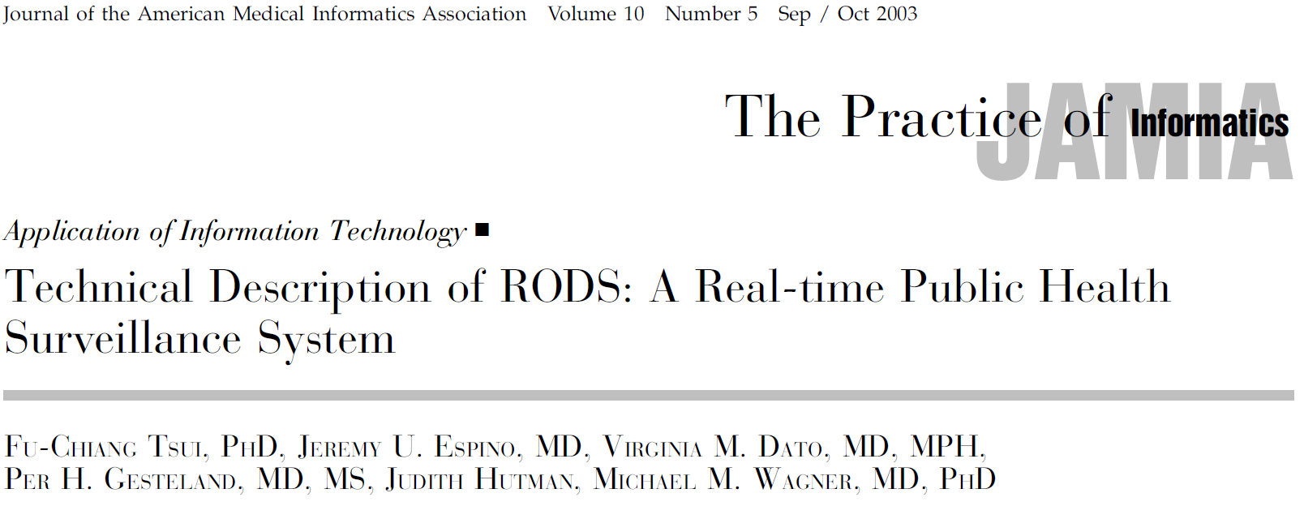
Examples of CDW Uses
Notes:
Autism study used a health care claims database, n = 97K+

Slide 5
Recent publications using RODS
Ye, Y., Tsui, F. R., Wagner, M., Espino, J. U. and Li, Q. (2014), Influenza detection from emergency department reports using natural language processing and Bayesian network classifiers, J Am Med Inform Assoc.
Wagner, M. M., Levander, J. D., Brown, S., Hogan, W. R., Millett, N. and Hanna, J. (2013), Apollo: giving application developers a single point of access to public health models using structured vocabularies and Web services, AMIA Annu Symp Proc, 2013: 1415--1424.
Liu, T. Y., Sanders, J. L., Tsui, F. C., Espino, J. U., Dato, V. M. and Suyama, J. (2013), Association of over-the-counter pharmaceutical sales with influenza-like-illnesses to patient volume in an urgent care setting, PLoS ONE, 8, 3: e59273.
Lee, B. Y., Tai, J. H., McGlone, S. M., Bailey, R. R., Wateska, A. R., Zimmer, S. M., Zimmerman, R. K. and Wagner, M. M. (2012), The potential economic value of a 'universal' (multi-year) influenza vaccine, Influenza Other Respi Viruses, 6, 3: 167--175.
Wagner, M., Cooper, G., Tsui, Fuchiang, Espino, J.U., Harkema, H., Levander, J., Villamarin, R., Millett, N., Brown, S.T. and Gallaggher, A. (2012), A Decision-Theoretic Model of Disease Surveillance and Control and a Prototype Implementation for the Disease Influenza, Data Engineering Workshops (ICDEW), 2012 IEEE 28th International Conference on: 49-54.
Lee, B. Y., Stalter, R. M., Bacon, K. M., Tai, J. H., Bailey, R. R., Zimmer, S. M. and Wagner, M. M. (2011), Cost-effectiveness of adjuvanted versus nonadjuvanted influenza vaccine in adult hemodialysis patients, Am. J. Kidney Dis., 57, 5: 724--732.

Slide 6
Marrying CDW and Big Data
One step in the process of whipping “Big Data” into shape for analysis
Aggregates data from various sources
Data is usually not real-time (but not too far behind)
Standardization, cleansing, and relational restructuring are common tasks that immediately precede CDW storage
Raghupathi and Raghupathi Health Information Science and Systems 2014 2:3

Slide 7
Big Data Analytics
What is Big Data?
Extremely large data sets (usually containing raw data) that may be analyzed computationally to reveal patterns, trends, and associations, especially relating to human behavior and interactions.
Why is it important?
Improve care, save lives, and lower costs (some estimates reach $300 Billion/year in U.S.)
The promise of predictive analytics
Predict cost-effective best practices, disease surveillance, etc.
The promise of prescriptive analytics
Adaptive interventions that redirect patient health trajectories that drift off-course
Enables personalized medicine via advanced clinical decision support
What is the future of Big Data?
As data capture technologies (e.g., fitness monitoring devices, the eventual Internet of Things) continue to evolve, we will be accumulating more and more Big Data
Generally speaking, healthcare isn’t really on the Big Data scene, yet, but with the advent of medical devices and cloud data capture technologies, we are certainly on the doorstep

Slide 8
Examples of Big Data Analytics Use in Healthcare
Columbia University Medical Center’s “complex correlations” project
Using physiological data from patients with brain injuries, provides information to aggressively treat complications
Reputedly diagnoses serious complications 48 hours earlier in patients suffering a bleeding stroke from a ruptured brain aneurysm
California-based Kaiser Permanente discovery of adverse drug effects and subsequent withdrawal of Vioxx

Slide 9
PCOR Context
The potential of fully functional EHRs that are aggregated in a CDW- all members of the clinical team have ready access to the ~latest information allowing for more coordinated, patient-centered care.
The information gathered by the primary care provider tells the emergency department clinician about the patient’s life threatening allergy, so that care can be adjusted appropriately, even if the patient is unconscious.
A patient can log on to his own record and see the trend of the lab results over the last year, which can help motivate him to take his medications and keep up with the lifestyle changes that have improved the numbers (ala HRA web portal) .
The lab results run last week are already in the record to tell the specialist what she needs to know without running duplicate tests.
The clinician’s notes from the patient’s hospital stay can help inform the discharge instructions and follow-up care and enable the patient to move from one care setting to another more smoothly.

Slide 10
Challenges of building a CDW
Legal
Data protection (consenting policies)
Data security (HIPAA, FERPA, FISMA regs)
Ethical dilemmas (revealing previously unknown Dx)
Architectural
Interoperability of existing systems
Record linkage (Master patient index)
Record anonymization, pseudonymization
Standardization
Data security
Updating, version control, adjudication decisions
Notes:
“The standardization process is best performed by the people who collect or manage the data. These are the clinicians or data managers of a particular treatment unit or clinical trial. However, the process is far from trivial, and they may make mistakes in this process that leads to incomplete or erroneous integration with the other data in the warehouse. It cannot be reasonably expected that busy clinicians and data managers are trained to completely understand the mapping process such that they rarely or never make mistakes. Therefore, it is useful for the contributors to be able to see how their data have been integrated, and work with curators familiar with the database to correct errors or make integration more complete.”
Jefferys et al., Interface Focus, 3, 2013.

Slide 11
Challenges of building a CDW
Procedural
Governance
Maintenance of institutional support
Team of custodians
Training and education
Regulatory compliant uses of the data
Notes:
“The standardization process is best performed by the people who collect or manage the data. These are the clinicians or data managers of a particular treatment unit or clinical trial. However, the process is far from trivial, and they may make mistakes in this process that leads to incomplete or erroneous integration with the other data in the warehouse. It cannot be reasonably expected that busy clinicians and data managers are trained to completely understand the mapping process such that they rarely or never make mistakes. Therefore, it is useful for the contributors to be able to see how their data have been integrated, and work with curators familiar with the database to correct errors or make integration more complete.”
Jefferys et al., Interface Focus, 3, 2013.

Slide 12
Limitations of CDW Research
All the usual quasi-experimental (lack of randomization) threats to validity (ala Cook & Campbell, 1979)
Selection bias (understand the sample and population from which data were drawn; differs across site, clinic, database)
Missing data bias (patient “drop-out” issues)
Data entry errors (garbage in, garbage out)
Vagaries of standardization decisions and measurement bias
Non-commensurate measures (How was the source data collected and coded)
Crudeness of measurement
Typical limitations of archival analysis
Availability of information
Changes in measurement procedures and instruments over time, places, & persons
Statistical anomalies with large data
Statistical vs Clinical significance
Data fishing influences on Type I error
Notes:
In general, the time spent collecting fresh data in a primary data collection study may be equivalent to the time spent understanding old data in a secondary data collection study. Data sets originally created with no intention of being archived for others’ later use (probably most studies) may have spotty documentation that will require good sleuthing skills.

Slide 13
Strengths of CDW Research
Share many of the advantages of Integrative Data Analysis (if you’re careful; see Curran & Hussong, Psychological Methods, 14, 2009; Hofer & Piccinin, Psychological Methods, 14, 2009)
Larger sample sizes and increased statistical power
Increased sample heterogeneity
Increased frequency of low base-rate outcomes
Breadth of measurement
Longitudinal hypotheses
CDW team establishes procedures for data sharing and data use so you can concentrate on the hypotheses and analysis
Cost effective research (even for projects collecting new data but requiring EMR information for recruitment)
Notes:
. The Integrative Analysis of Longitudinal Studies on Aging (IALSA) ), described as an international collaborative research network, focuses on changes in health and cognition and encourages researchers associated with the incorporated studies to use old measures or administer new measures in a way to maximize comparability.

Slide 14
The Birth of an OUHSC CDW
Dr. Zsolt Nagykaldi has been advocating for years
NagyKaldi & Shay initial HSC CDW sketch
Conversation changed when EHR came asking for assistance
Important for OUHSC's ability to
compete for grants
care for patients
Present needs assessed: Warehouses for Research and QAQI
identification and recruitment of potential research participants
epidemiologic evaluation of clinical information
surveillance of disease
quality of care assessments
cost-effectiveness of prevention and treatment strategies

Slide 15
Progress to Date
OSCTR and Pediatrics funding secured for initial development and deployment
Initial design complete
Computing infrastructure up and running
Product security review is complete
Product support plan is complete
CDW development and maintenance teams assembled
3 data science faculty members
Campus IT support personnel identified
Warehouse DBA
Warehouse system navigator hired
Business administrator
Three Pilot Projects underway at varying stages of development

Slide 16







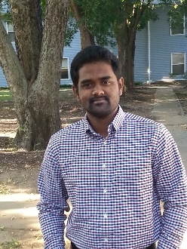
Data Science Faculty
OUHSC IT Support
Bard
Beasley
Nagykaldi
Mack
DeWitt
Warehouse Support Team
Centricity Support Team
Antry
Marshall
Mandem
McGann
Pearson

Slide 17
Current Response to CDW Challenges
Legal
Data protection (consenting policies)- IRB reviews and approves protocol
Data security (HIPAA, FERPA, FISMA regs)- IT security review of infrastructure
Ethical dilemmas (revealing previously unknown Dx)- IRB review
Architectural
Interoperability of existing systems- Plain text, nonproprietary file formats
Record linkage (Master patient index)- Project dependent
Record anonymization, pseudonymization- replace or salt+hash, whenever possible
Standardization- Project dependent
Data security- Minimum Necessary Standard + IT recommendations
Updating, version control, adjudication decisions- differs by ecosystem column (see slide 18)
Notes:
“The standardization process is best performed by the people who collect or manage the data. These are the clinicians or data managers of a particular treatment unit or clinical trial. However, the process is far from trivial, and they may make mistakes in this process that leads to incomplete or erroneous integration with the other data in the warehouse. It cannot be reasonably expected that busy clinicians and data managers are trained to completely understand the mapping process such that they rarely or never make mistakes. Therefore, it is useful for the contributors to be able to see how their data have been integrated, and work with curators familiar with the database to correct errors or make integration more complete.”
Jefferys et al., Interface Focus, 3, 2013.

Slide 18
Challenges of building a CDW
Procedural
Governance- roster established, but need to convene
Maintenance of institutional support- underway
Team of custodians- established
Training and education- intake process established; coordinated approach established
Regulatory compliant uses of the data- IRB review required
Notes:
“The standardization process is best performed by the people who collect or manage the data. These are the clinicians or data managers of a particular treatment unit or clinical trial. However, the process is far from trivial, and they may make mistakes in this process that leads to incomplete or erroneous integration with the other data in the warehouse. It cannot be reasonably expected that busy clinicians and data managers are trained to completely understand the mapping process such that they rarely or never make mistakes. Therefore, it is useful for the contributors to be able to see how their data have been integrated, and work with curators familiar with the database to correct errors or make integration more complete.”
Jefferys et al., Interface Focus, 3, 2013.

Slide 19
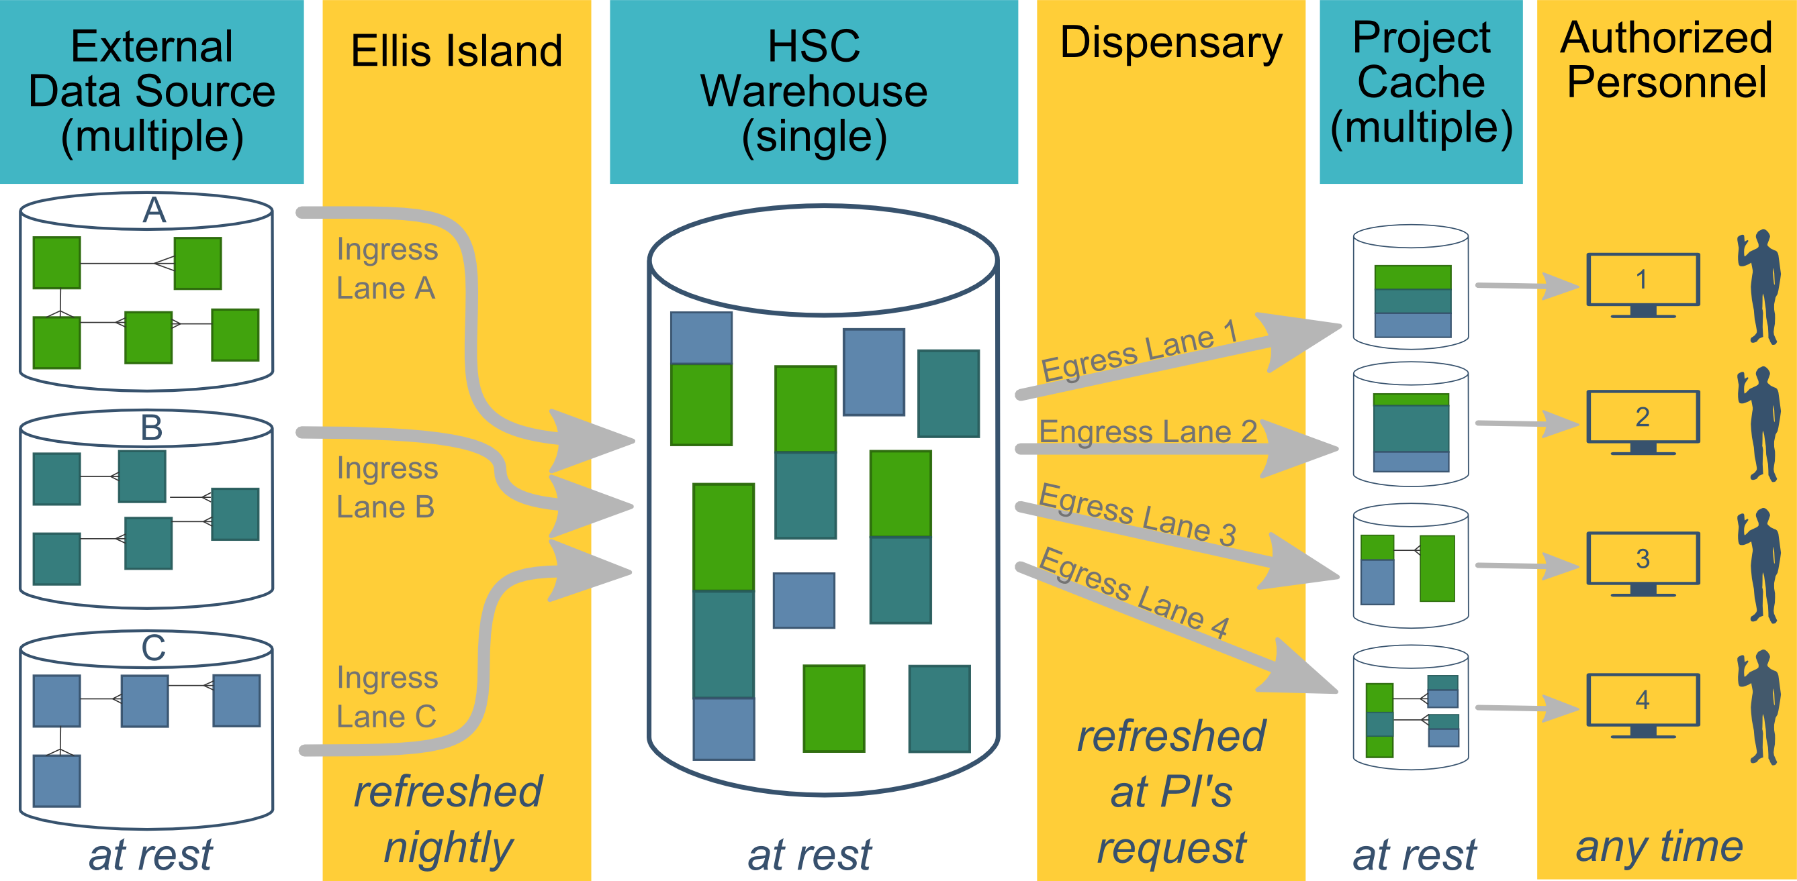
Ecosystem Architecture
Data Source (column 1): contains unique info
Warehouse (column 3): contains copy after manipulation
Project Cache (column 5): contains copy of copy after a lot of manipulation
Notes:
The entire ecosystem can be represented by these six columns. The EMR and other collection databases sit in the 1st column and feed the warehouse in the third. This movement is automated. Inside the warehouse, the info from the different sources are combined. Different patients can be placed in the same table. Perhaps more importantly, records for a single patient that are scattered across different sources are linked.
When a investigation is approved by the IRB, we can develop a tiny database in REDCap that contains the dataset needed for their analysis (5th column). There are a few reasons why REDCap is preferred. First, it’s more secure and scalable than distributing loose Excel files. Second, REDCap has a lot of momentum and adoption, so it’s become familiar to a lot of people on campus. The same software system the clinical researcher learned (for example) for randomized trials is leverage here for these observational studies. Although the research/QA methodology is very different, the software is the same. We expect this familiarity to grow on campus, especially as systems like Qualtrics become less available.

Slide 20
Benefits over ad-hoc EMR Extracts
In contrast to the current approach of using EMR data in research & QA, this new system provides:
Coordinated datasets across sources (combining patients and variables)
Automated updates to datasets (important for on-going QA)
More streamlined IRB approval (hopefully)
More secure delivery through REDCap (instead of loose Excel files)
More consistent experience for multiple research/QA investigations
Notes:
The only current capability on campus is to request individual extracts from the data source stewards.

Slide 21
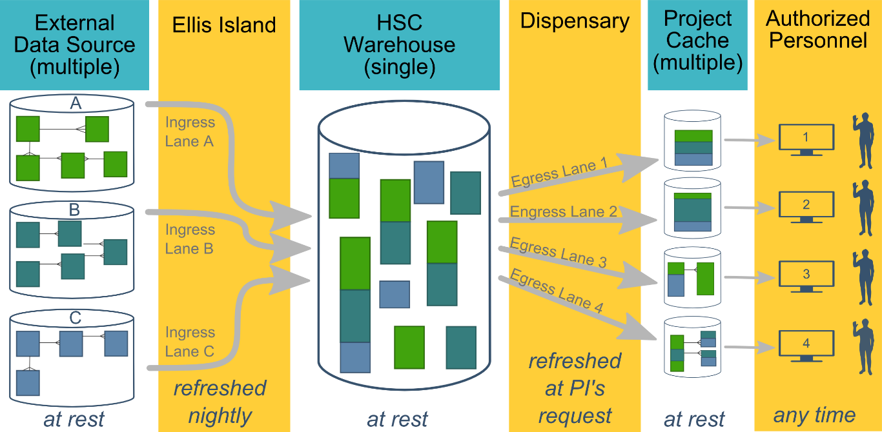
Overall Goals
Existing investigations can proceed quicker and more frequently.
The process is more user-friendly and consistent across different investigations & EMRs.
More complicated investigation are possible (by combining patients & measurements across data sources).
Notes:
We want (1) the things you were already planning to be more streamlined, and (2) provide richer data that were infeasible until now.

Slide 22
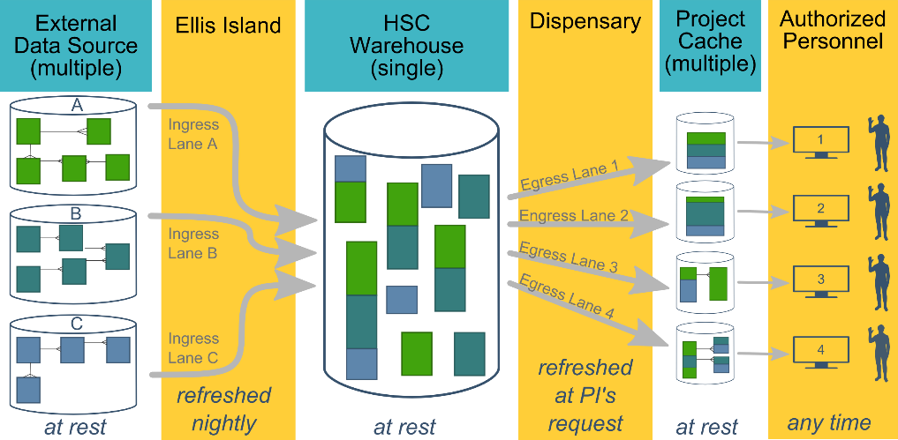
Instantiation Activities
Creating and maintaining the warehouse ecosystem involves three different levels:
Ecosystem (eg, configuring the database VM)
Data source (eg, connecting an EMR's feed to the warehouse)
Project (eg, processing data from specific patients for a single IRB-approved investigation)
Notes:
To start and continue this entire system, there are three levels of activities.

Slide 23
Requirements Per Ecosystem
These steps are required for the overall ecosystem. This work is required once for our campus, and doesn't need to be replicated for each additional data sources or investigation.
Planning meetings with Campus IT and shared services
Campus IT security review (and annual re-reviews)
Creating multiple VMs (virtual machines)
Installing and patching software on each machine
Establish and maintaining secure connections between the 2nd-5th cols.
Assembling team (DBA, EMR reporter, REDCap admin, statistician)
Notes:
This work is required once for our *campus*, and doesn't need to be replicated for each additional data sources or investigation.
{Read through slides, but not the sub-points.}
3. Creating multiple VMs (virtual machines)
* *HSC Warehouse*: One Windows Server VM hosting the SQL Server (figure's third column).
* *Ellis Island and Dispensary*: One Windows Server VM running R and C# (figure's second and fourth column).
* *Project Cache*: Two Windows Servers compose one REDCap instance (figure's fifth column).
4. Installing and patching software on each machine.
* OSes
* Database Servers (SQL Server and MySQL)
* Database admin tools (SQL Server Management Studio, MySQL Workbench, phpMyAdmin)
* Application software (R and C#)
5. Establish and maintaining secure connections between the 2nd, 3rd, 4th, and 5th columns.
* Network/firewall permissions between the different machines.
* Specific user accounts on each machine (eg, OS accounts plus DB accounts).
6. Assembling team
* DBA for warehouse (schema, performance, reliability & backups, security, communication w/ IT & S2).
* Former EMR report writer (expertise at the connections between a pt visit and a db record).
* REDCap administrator
* Statistician (manipulate and/or analyze data)

Slide 24

Requirements Per Data Source
Necessary for each data source (eg, once for Centricity, once for Meditech…)
Agreement with data source owner.
Establish a periodic automated data feed.
Secure licenses for GUI and specialized software (eg, Crystal Reports & Centricity front-end).
Learn data source.
Database schema
Sampling plan (and source of missingness)
Write code to:
Transform EAV schema into warehouse-friendly schema.
Combine measures from different data sources
Link clients from different data sources
Notes:
1. Agreement with data source owner.
1. Establish a periodic automated data feed.
* Configure transport layer & software
1. Secure licenses for GUI and specialized software (eg, Crystal Reports & Centricity front-end).
1. Learn data source.
* Database schema
* Which 15 tables (out of the 200) are relevant to the current goals)?
* How are these tables related to each other?
* Sampling plan (and sources of missingness)
* {Screenshot of part of Centricity schema}
1. Write code to:
* Transform EAV schema into warehouse-friendly schema.
* Combine measures from different data sources
* Link clients from different data sources
* {Screenshot of wide to long transformation}
* {Screenshot of warehouse schema}

Slide 25
Centricity Requirements Timeline
Necessary for each data source
Agreement with data source owner: Feb 2015 - Aug 2015
Establish a periodic automated data feed: Dec 2015 – Jun 2016
Secure licenses for GUI and specialized software (eg, Crystal Reports & Centricity front-end): Jan 2016
Learn data source: Ongoing
Database schema
Sampling plan (and source of missingness)
Write code to: Ongoing
Transform EAV schema into warehouse-friendly schema.
Combine measures from different data sources
Link clients from different data sources
Notes:
1. Agreement with data source owner.
1. Establish a periodic automated data feed.
* Configure transport layer & software
1. Secure licenses for GUI and specialized software (eg, Crystal Reports & Centricity front-end).
1. Learn data source.
* Database schema
* Which 15 tables (out of the 200) are relevant to the current goals)?
* How are these tables related to each other?
* Sampling plan (and sources of missingness)
* {Screenshot of part of Centricity schema}
1. Write code to:
* Transform EAV schema into warehouse-friendly schema.
* Combine measures from different data sources
* Link clients from different data sources
* {Screenshot of wide to long transformation}
* {Screenshot of warehouse schema}

Slide 26
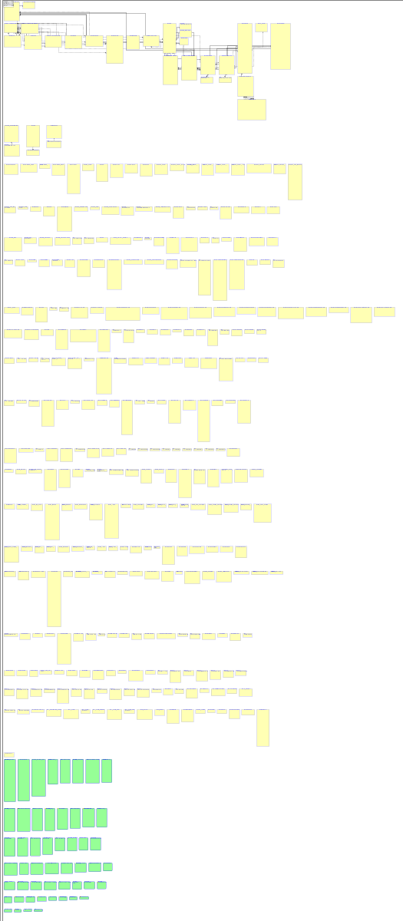
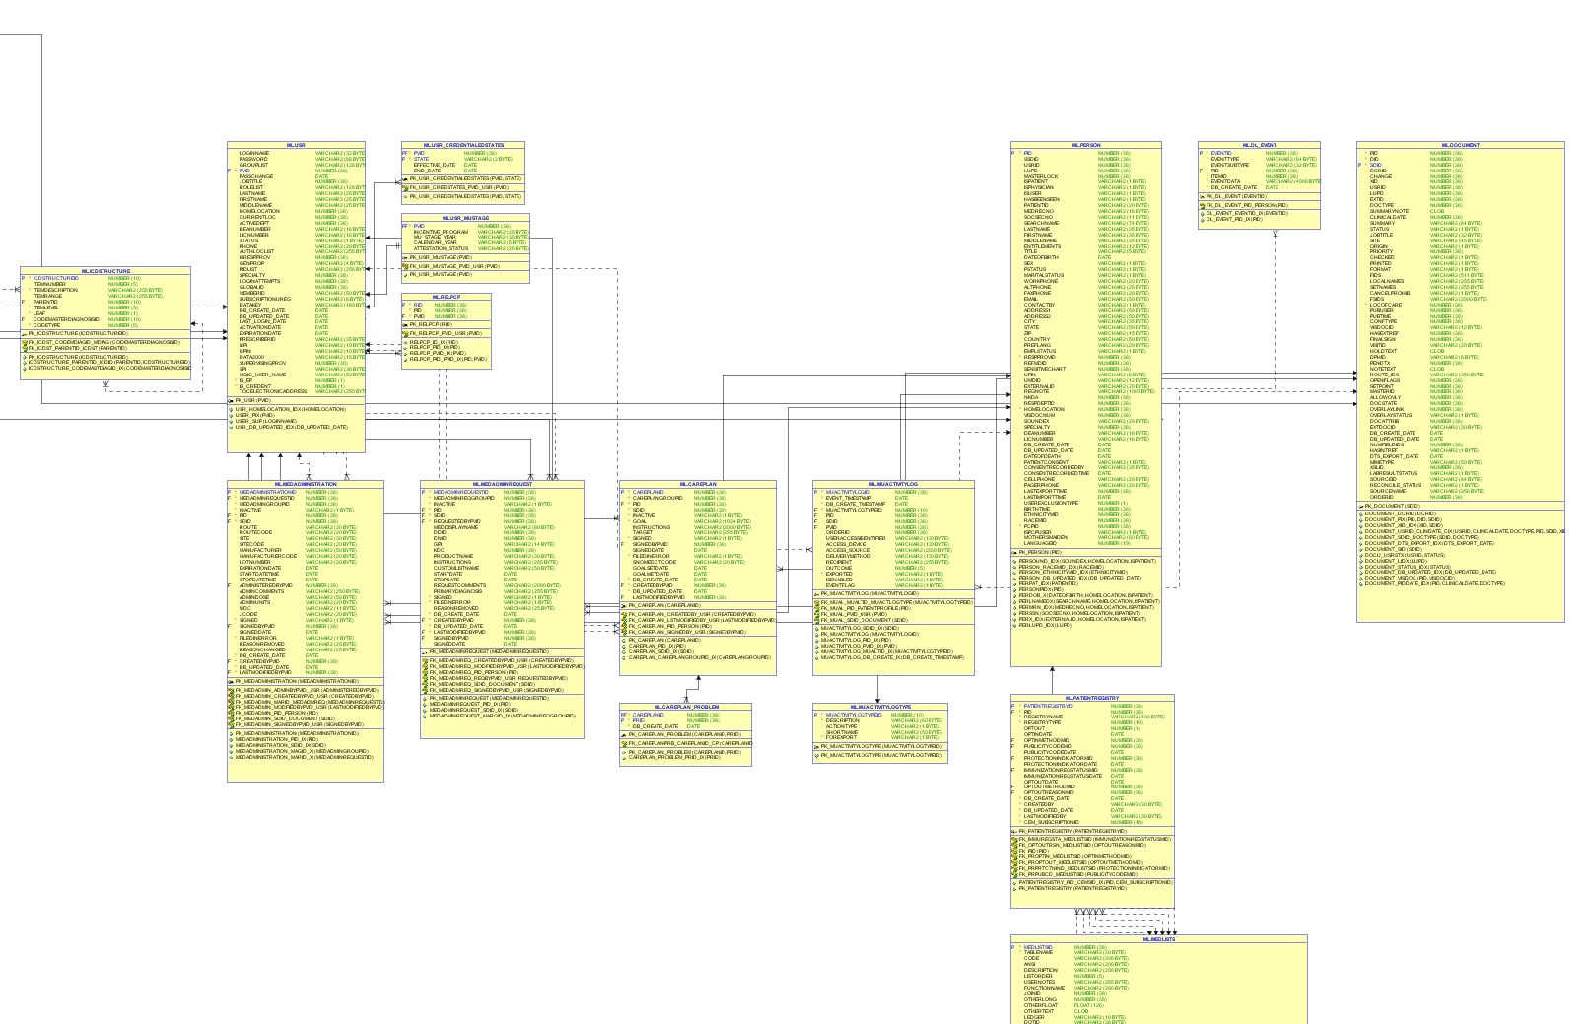
Part of Centricity

Slide 27
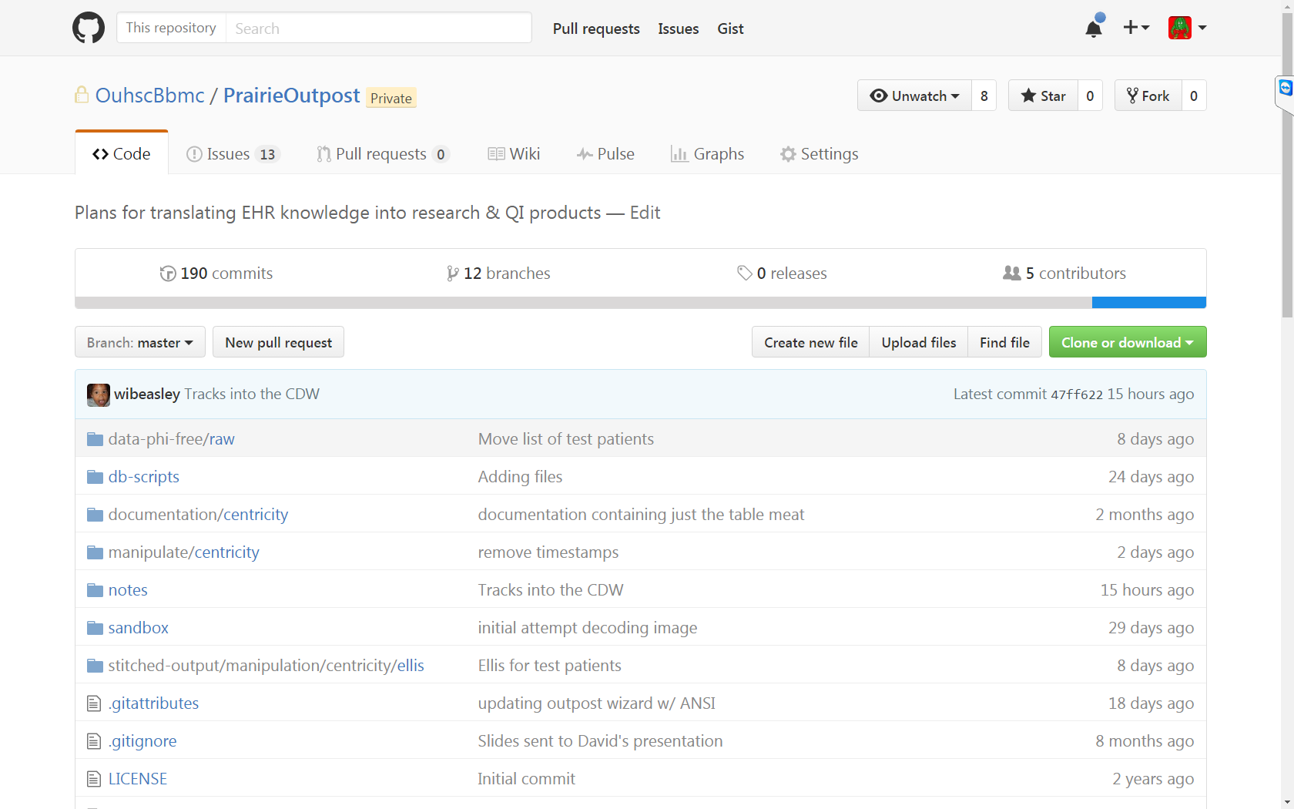

Slide 28
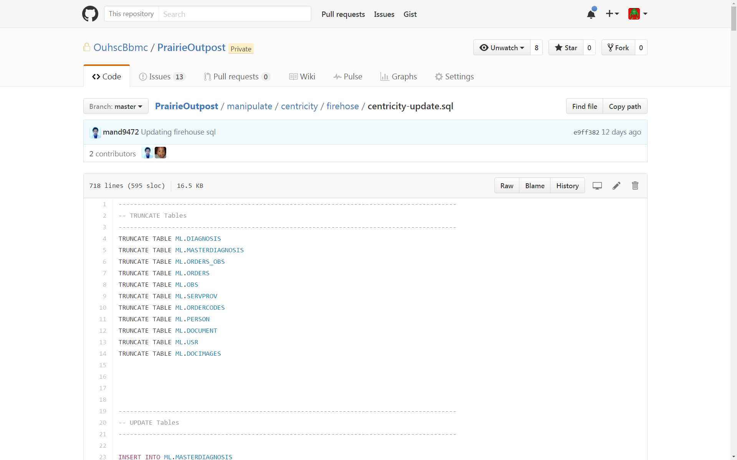

Slide 29
Requirements Per Project/Investigation
Necessary for each investigation (eg, once for Gillaspy/Weedn, once for Miller…)
IRB approval for investigation
IRB approval for warehouse collaborators
Teach us research goals & specifics
Write code to transform warehouse into research-friendly schema.
Establish REDCap cache
Write code to transfer data from warehouse to cache
Educate researchers how REDCap & cache work
Notes:
{Go through 1-5}
5. Establish REDCap cache
* We create schema {Screenshot of REDCap project}
* Create user account
* Create API token
* Create starter script in R or SAS
For #8,
* to keep data secure once it's in the cache.
* their cache's schema relates to their research question.
* to analyze their data (if they're doing the analysis)
1. If BERD/BBMC is doing the analysis, keep the structure as reproducible as possible, while protecting PHI.
* {Screenshot of R}
* {Screenshot of GitHub}

Slide 30
Requirements Per Project/Investigation
Necessary for each investigation (eg, once for Gillaspy/Weedn, once for Miller…)
IRB approval for investigation
IRB approval for warehouse collaborators
Teach us research goals & specifics
Write code to transform warehouse into research-friendly schema.
Establish REDCap cache
Write code to transfer data from warehouse to cache
Educate researchers how REDCap & cache work
Notes:
{Go through 1-5}
5. Establish REDCap cache
* We create schema {Screenshot of REDCap project}
* Create user account
* Create API token
* Create starter script in R or SAS
For #8,
* to keep data secure once it's in the cache.
* their cache's schema relates to their research question.
* to analyze their data (if they're doing the analysis)
1. If BERD/BBMC is doing the analysis, keep the structure as reproducible as possible, while protecting PHI.
* {Screenshot of R}
* {Screenshot of GitHub}

Slide 31
Processes for learning research goals & specifics
1. Project staff meet with CDW liaison (Antry) to discuss project goals and determine which EMR information is necessary.
Visual inspection of EMR fields
Identify subset boundary conditions (e.g., only pull patient records between dates X and Y)
Exploration of consistency in data documentation
2. CDW software team (Beasley and Mandem) meets with liaison to determine the extract parameters and devise the initial warehouse schema
3. DBA (Mandem) builds extract queries and front-end cache system (usually REDCap).
4. Liaison performs “sweep and specify” approach to narrow down variable coding conventions and finalize extract parameters.
5. CDW software team make necessary change based on step 4 findings.

Slide 32
Example of Sweep and Specify Necessity
Sloppy Orders
Orders and labs for the genetic screens were not well-structured or entered consistently.
Consequently, much more effort is required to leverage that information for an investigation.
Instead of a value like 'CPT-5050' in the code ield, it has values like 'ZZZZ' and a free-text value in description.
Like most free-text, the entries are inconsistent and difficult to process without a human.
To address this, we're using a strategy that we're tentatively calling "sweep & specify"

Slide 33
Sweep & Specify Strategy: Description
The CDW staff sweeps up possibilities, then the investigator indicates their explicit specifications.
1. In an early meeting with the CDW staff, the investigator describes the types of desired orders.
2. The CDW staff later uses pattern matching against all description values to enumerate the probable desired orders. These are stored as metadata in a CSV file.
3. The investigator then indicates in the metadata file:
If the order description is desired (i.e., true/false)
How the order should be classified (e.g., 'ex-scrn' and 'exome' both become 'exome-screen')
4. The CDW staff incorporates the metadata file in all future extractions for that investigator.

Slide 34
Sweep & Specify Stategy: Example
The order_code alue isn't helpful by itself (e.g., 'zzzz')
The first five rows collapse into one category.
The 6th row (e.g., 'zzzz' and 'CPGH') looks similar, but the investigator decided it wasn't relevant. They marked desired as 'FALSE' and left it uncategorized.
category_name | category_id | order_code | order_description | desired | comments
Whole Genome Array | 1 | 81228 | CGH | TRUE
Whole Genome Array | 1 | x | CGH | TRUE
Whole Genome Array | 1 | zz | CGH | TRUE
Whole Genome Array | 1 | zzzz | CGH | TRUE
Whole Genome Array | 1 | zzzz | CWGH | TRUE
-- | -- | zzzz | CPGH | FALSE | Unrelated to CGH
Carinitine determination-plasma, Acylcarnitine analysis-plasma | 2 | 82017 | CARNCOMBO | TRUE
Creatine and guanidinoacetate determination-plasma | 3 | 82540 | CREAGUAN | TRUE

Slide 35
Epidemiology of Obesity among Child & Adolescent Patients
PIs: Drs. Gillaspy and Weedn

Slide 36
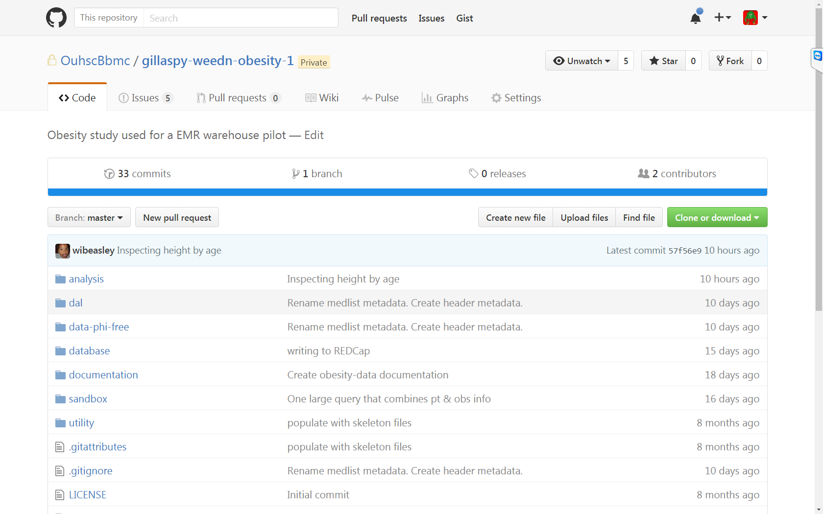

Slide 37
Obesity Project Requirements
Necessary for each investigation
IRB approval for investigation- Jul 2010 & Jan 2014
IRB approval for warehouse collaborators- Aug 2015
Teach us research goals & specifics- Aug 2015
Write code to transform warehouse into research-friendly schema.
Notes:
{Go through 1-5}
5. Establish REDCap cache
* We create schema {Screenshot of REDCap project}
* Create user account
* Create API token
* Create starter script in R or SAS
For #8,
* to keep data secure once it's in the cache.
* their cache's schema relates to their research question.
* to analyze their data (if they're doing the analysis)
1. If BERD/BBMC is doing the analysis, keep the structure as reproducible as possible, while protecting PHI.
* {Screenshot of R}
* {Screenshot of GitHub}

Slide 38
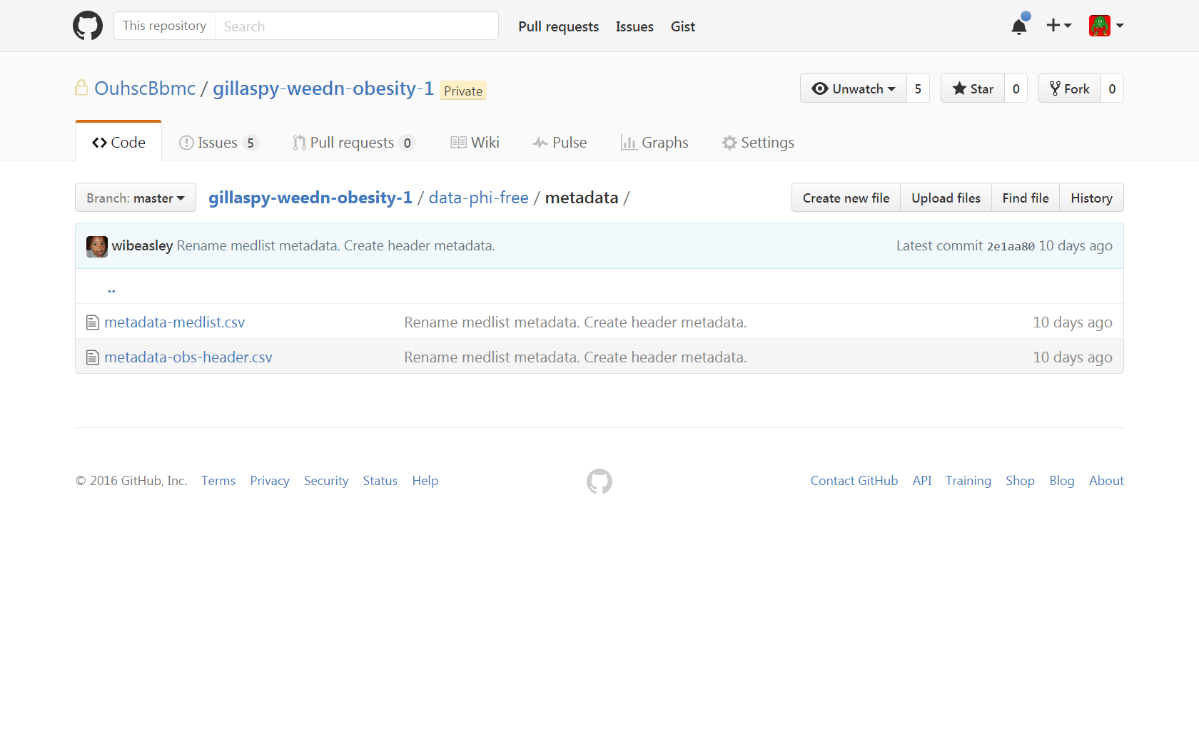

Slide 39
Obesity Project Requirements
Necessary for each investigation
IRB approval for investigation- Jul 2010 & Jan 2014
IRB approval for warehouse collaborators- Aug 2015
Teach us research goals & specifics- Aug 2015
Write code to transform warehouse into research-friendly schema.
Establish REDCap cache
Notes:
{Go through 1-5}
5. Establish REDCap cache
* We create schema {Screenshot of REDCap project}
* Create user account
* Create API token
* Create starter script in R or SAS
For #8,
* to keep data secure once it's in the cache.
* their cache's schema relates to their research question.
* to analyze their data (if they're doing the analysis)
1. If BERD/BBMC is doing the analysis, keep the structure as reproducible as possible, while protecting PHI.
* {Screenshot of R}
* {Screenshot of GitHub}

Slide 40
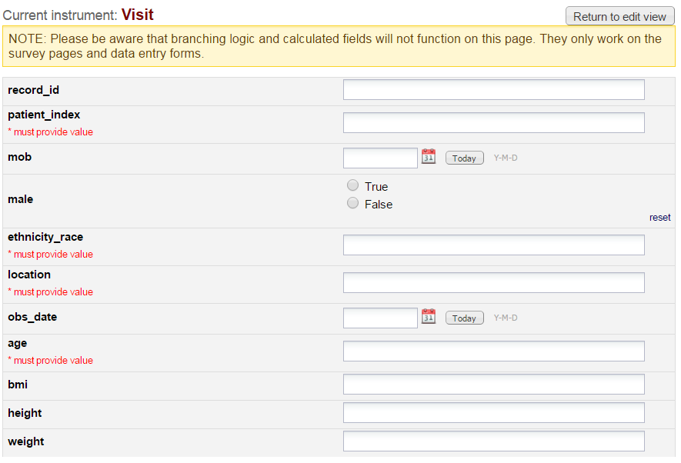

Slide 41
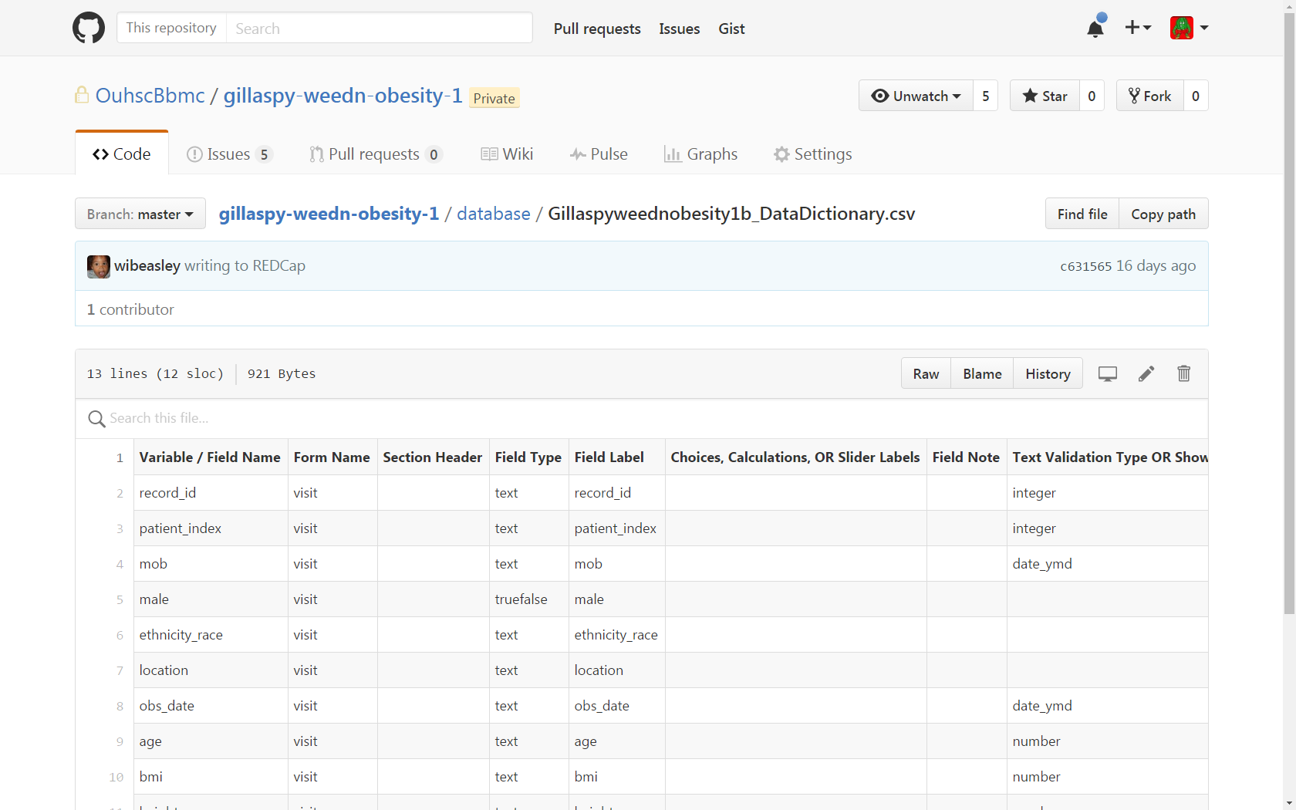

Slide 42
Obesity Project Requirements
Necessary for each investigation
IRB approval for investigation- Jul 2010 & Jan 2014
IRB approval for warehouse collaborators- Aug 2015
Teach us research goals & specifics- Aug 2015
Write code to transform warehouse into research-friendly schema.
Establish REDCap cache
Write code to transfer data from warehouse to cache
Notes:
{Go through 1-5}
5. Establish REDCap cache
* We create schema {Screenshot of REDCap project}
* Create user account
* Create API token
* Create starter script in R or SAS
For #8,
* to keep data secure once it's in the cache.
* their cache's schema relates to their research question.
* to analyze their data (if they're doing the analysis)
1. If BERD/BBMC is doing the analysis, keep the structure as reproducible as possible, while protecting PHI.
* {Screenshot of R}
* {Screenshot of GitHub}

Slide 43
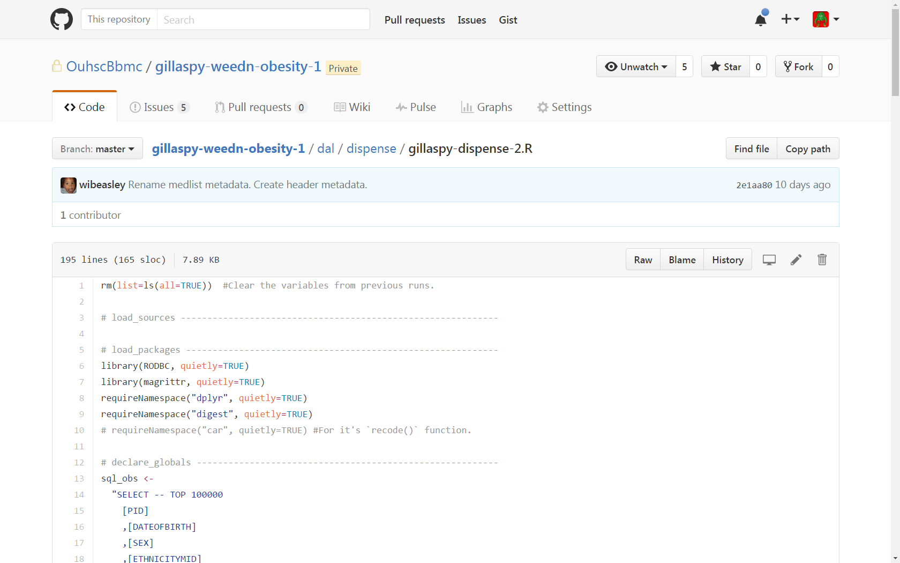

Slide 44
Obesity Project Requirements
Necessary for each investigation
IRB approval for investigation- Jul 2010 & Jan 2014
IRB approval for warehouse collaborators- Aug 2015
Teach us research goals & specifics- Aug 2015
Write code to transform warehouse into research-friendly schema.
Establish REDCap cache
Write code to transfer data from warehouse to cache
Educate researchers how REDCap & cache work
Notes:
{Go through 1-5}
5. Establish REDCap cache
* We create schema {Screenshot of REDCap project}
* Create user account
* Create API token
* Create starter script in R or SAS
For #8,
* to keep data secure once it's in the cache.
* their cache's schema relates to their research question.
* to analyze their data (if they're doing the analysis)
1. If BERD/BBMC is doing the analysis, keep the structure as reproducible as possible, while protecting PHI.
* {Screenshot of R}
* {Screenshot of GitHub}

Slide 45
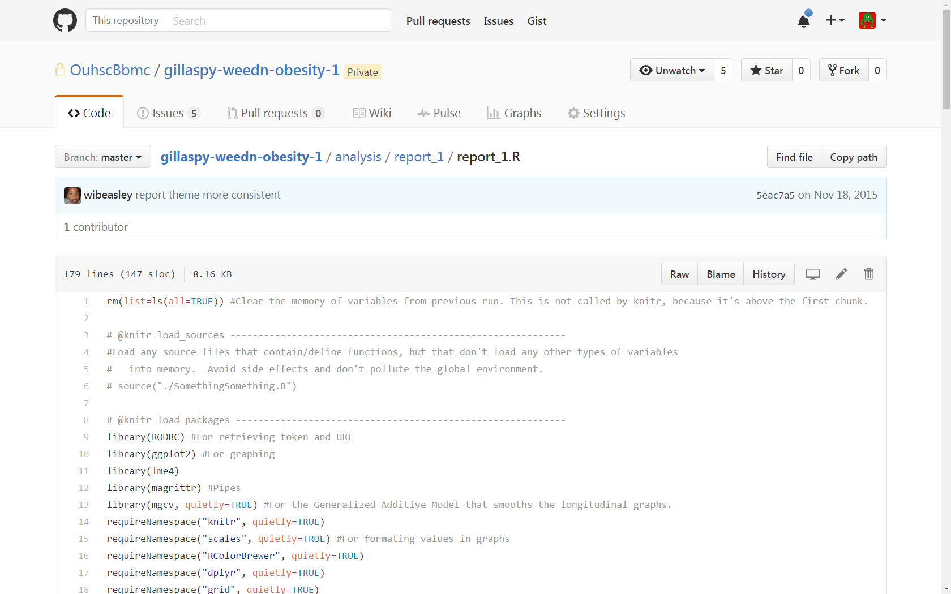

Slide 46
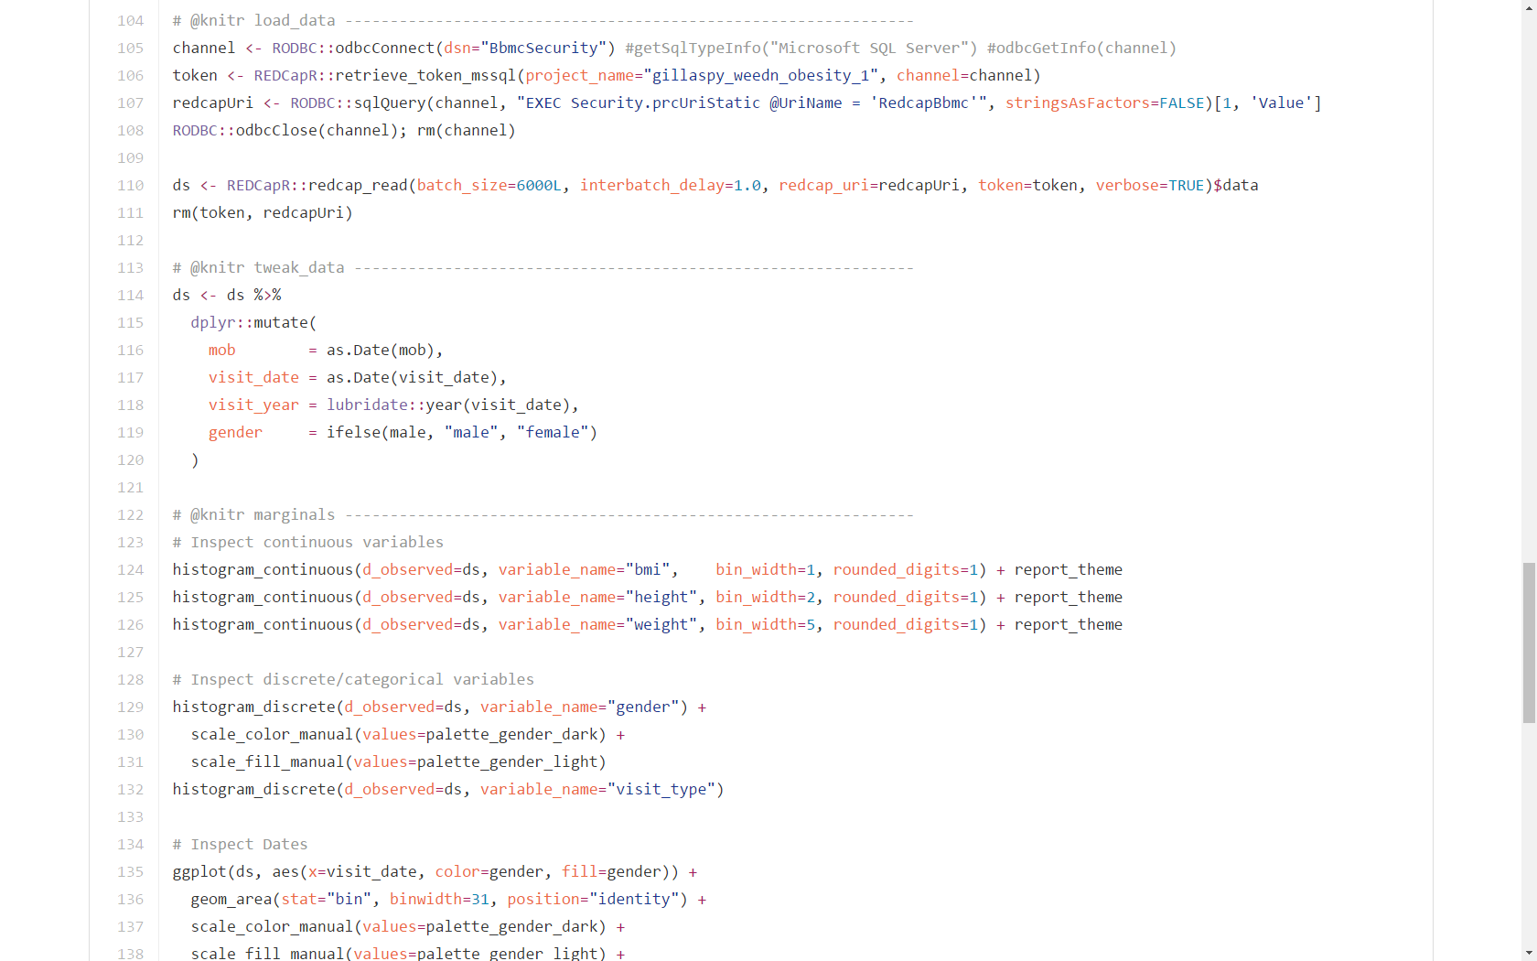

Slide 47
SAS Example
filename in "E:\encrypted_drive\aslan\apicall.csv";
filename out "E:\encrypted_drive\aslan\redcap.csv";
%let token = xxxxx;
"%NRStr(content=record&type=flat&format=csv&fields=last_first_mi&token=)&token%NRStr(&_x=1)";
%let url = "https://bbmc.ouhsc.edu/api/";
data _null_ ;
file in ;
put "%NRStr(content=record&type=flat&format=csv&token=)&token";
run;
proc http
in=in
out=out
url=&url
method="post";
run;
Adapted from Linda Carlin’s and Kevan Essmyer’s posts at https://groups.google.com/forum/#!topic/project-redcap/MS_4_l1q-WU

Slide 48
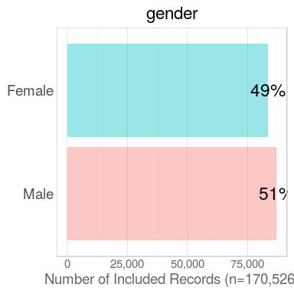
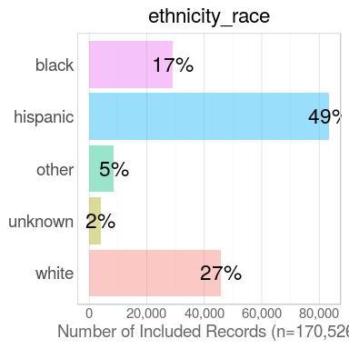
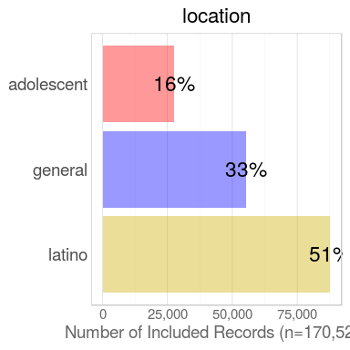
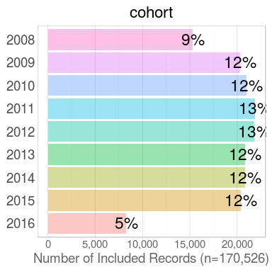
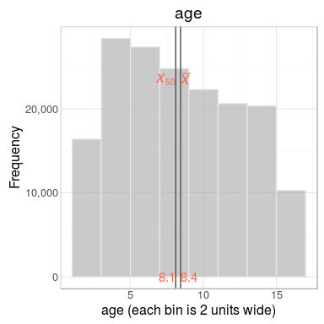
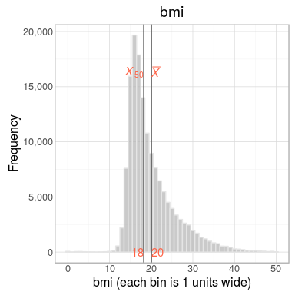

Slide 49
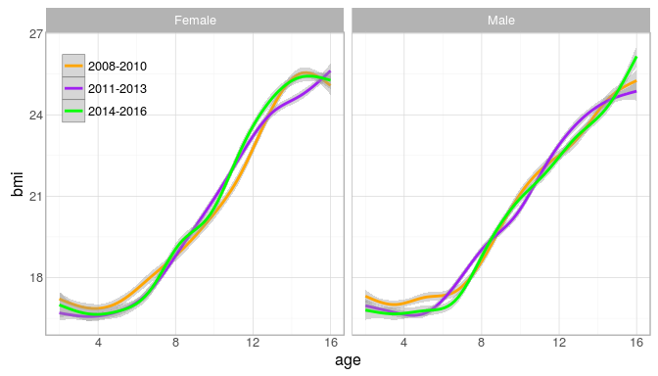
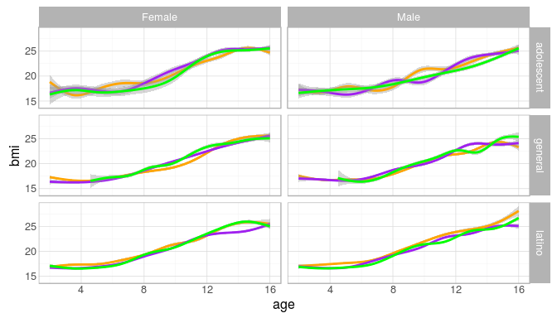

Slide 50
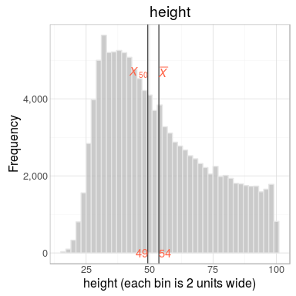
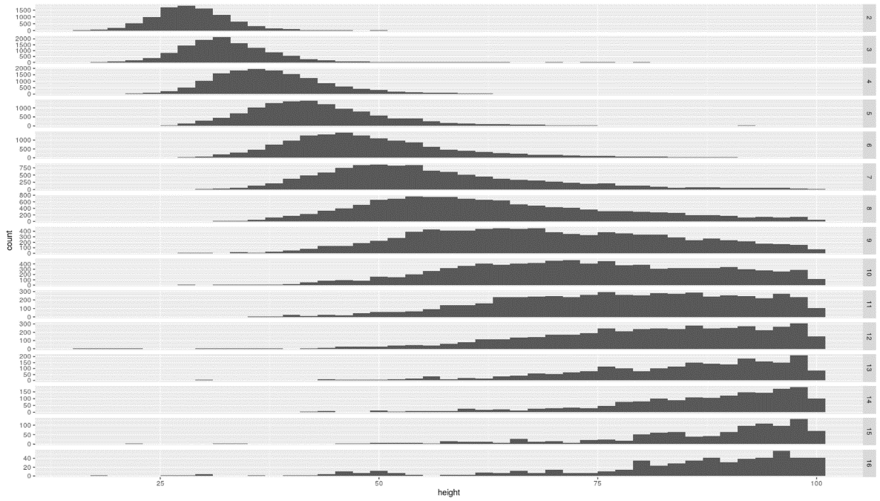
Obesity Project Challenges
Height data entry errors appear rampant (confusion over unit of measurement- cm vs inch)
Percentiles provided do not appear to stratify on gender
Which measurement counts? Multiple measurements per child in most instances.

Slide 51
Obesity Project Tasks Remaining
Clean up percentile scores for weight, height, and BMI
Merge project-collected Pediatric Behavioral Health Screen measures

Slide 52
ADHD Medication Titration Management and Patient Compliance
PIs: Drs. O’Banion & Wolraich

Slide 53
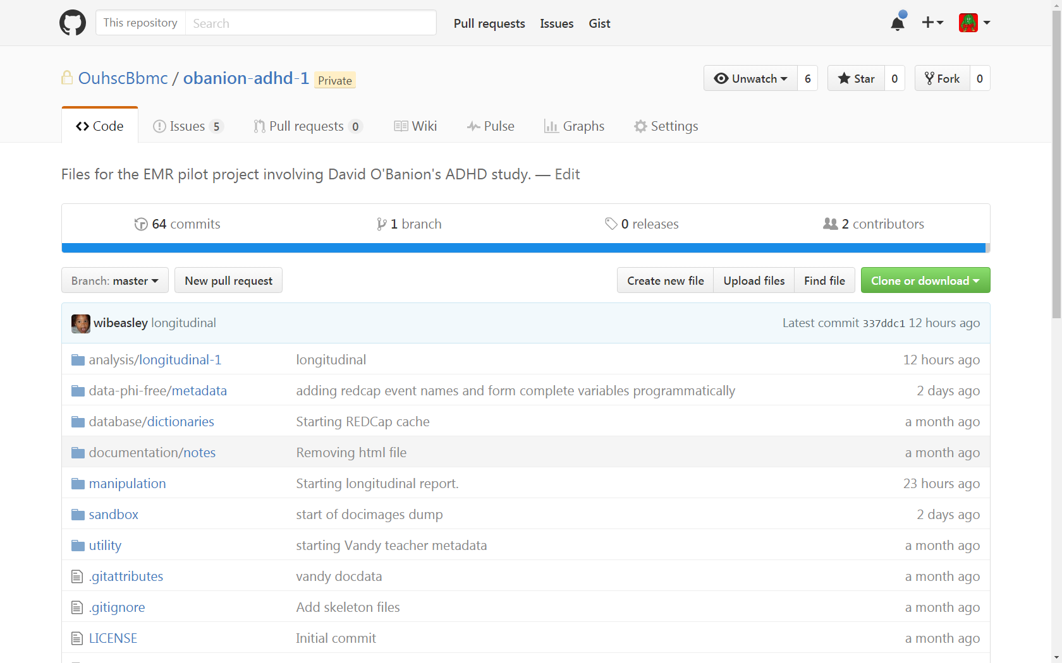

Slide 54
ADHD Project Requirements
Necessary for each investigation
IRB approval for investigation- Aug 2012
IRB approval for warehouse collaborators- Feb 2016
Teach us research goals & specifics- Feb 2016 – Mar 2016
Write code to transform warehouse into research-friendly schema.
Notes:
{Go through 1-5}
5. Establish REDCap cache
* We create schema {Screenshot of REDCap project}
* Create user account
* Create API token
* Create starter script in R or SAS
For #8,
* to keep data secure once it's in the cache.
* their cache's schema relates to their research question.
* to analyze their data (if they're doing the analysis)
1. If BERD/BBMC is doing the analysis, keep the structure as reproducible as possible, while protecting PHI.
* {Screenshot of R}
* {Screenshot of GitHub}

Slide 55
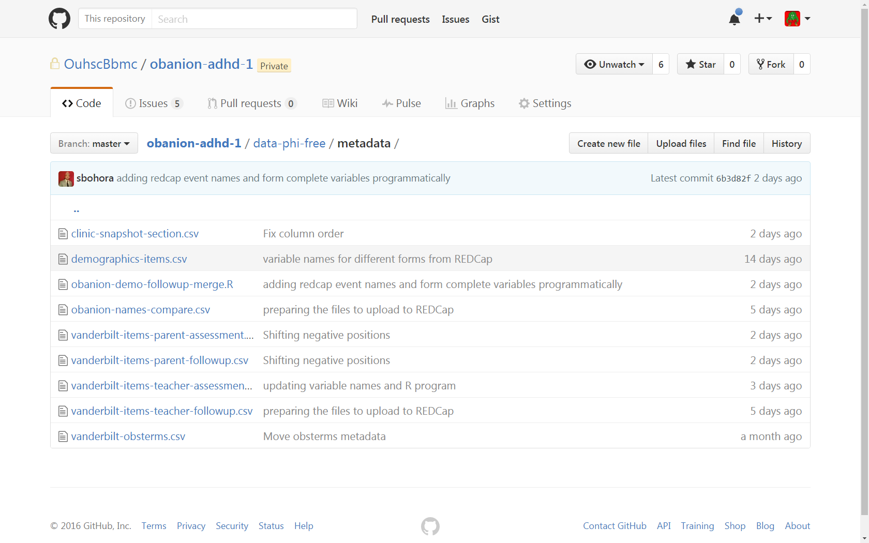

Slide 56
ADHD Project Requirements
Necessary for each investigation
IRB approval for investigation- Aug 2012
IRB approval for warehouse collaborators- Feb 2016
Teach us research goals & specifics- Feb 2016 – Mar 2016
Write code to transform warehouse into research-friendly schema.
Establish REDCap cache
Notes:
{Go through 1-5}
5. Establish REDCap cache
* We create schema {Screenshot of REDCap project}
* Create user account
* Create API token
* Create starter script in R or SAS
For #8,
* to keep data secure once it's in the cache.
* their cache's schema relates to their research question.
* to analyze their data (if they're doing the analysis)
1. If BERD/BBMC is doing the analysis, keep the structure as reproducible as possible, while protecting PHI.
* {Screenshot of R}
* {Screenshot of GitHub}

Slide 57
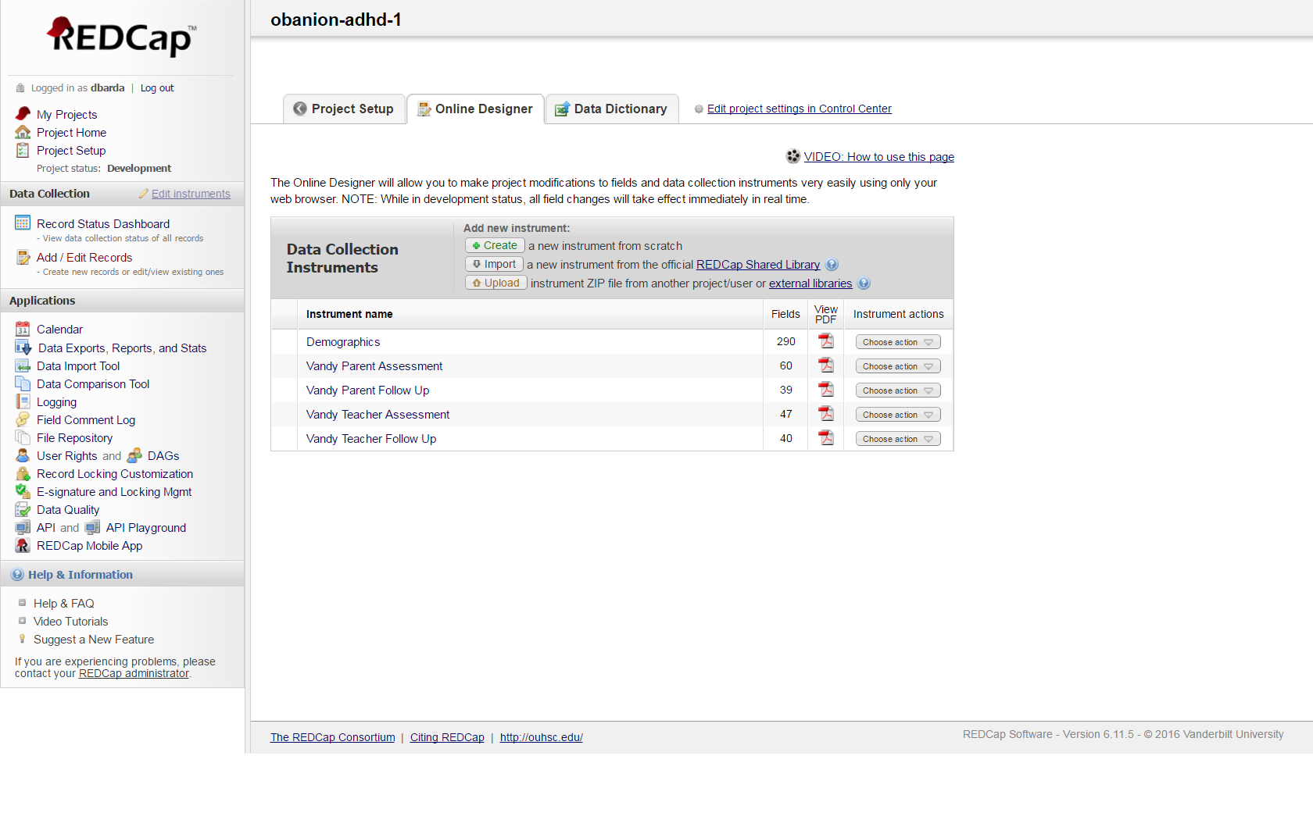

Slide 58
ADHD Project Requirements
Necessary for each investigation
IRB approval for investigation- Aug 2012
IRB approval for warehouse collaborators- Feb 2016
Teach us research goals & specifics- Feb 2016 – Mar 2016
Write code to transform warehouse into research-friendly schema.
Establish REDCap cache
Write code to transfer data from warehouse to cache
Notes:
{Go through 1-5}
5. Establish REDCap cache
* We create schema {Screenshot of REDCap project}
* Create user account
* Create API token
* Create starter script in R or SAS
For #8,
* to keep data secure once it's in the cache.
* their cache's schema relates to their research question.
* to analyze their data (if they're doing the analysis)
1. If BERD/BBMC is doing the analysis, keep the structure as reproducible as possible, while protecting PHI.
* {Screenshot of R}
* {Screenshot of GitHub}

Slide 59
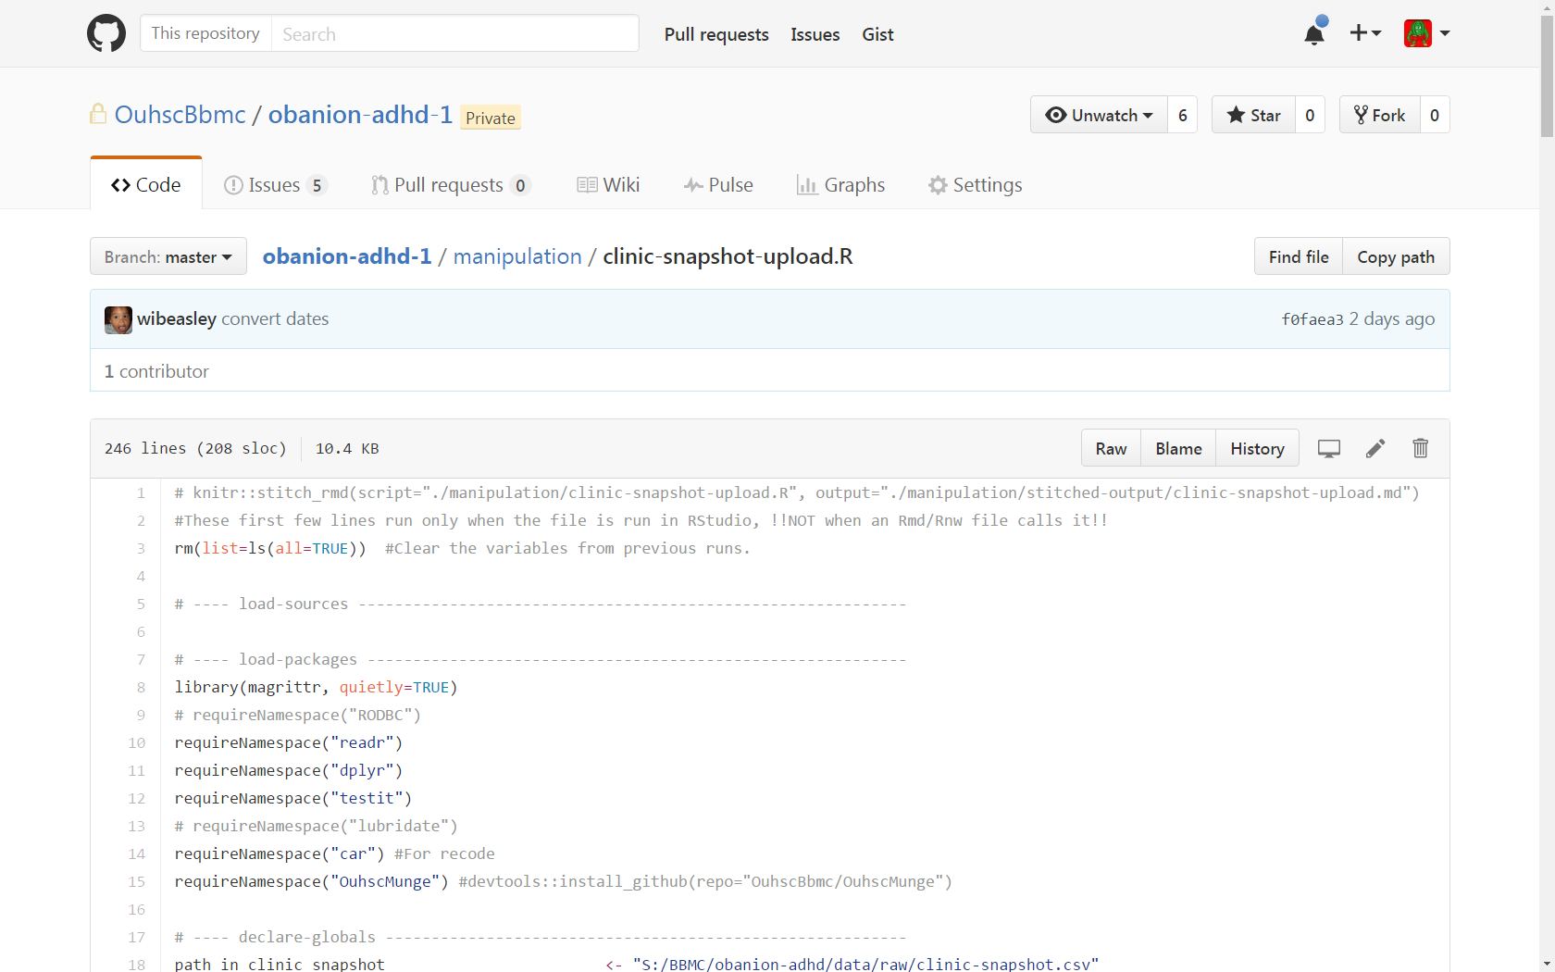

Slide 60
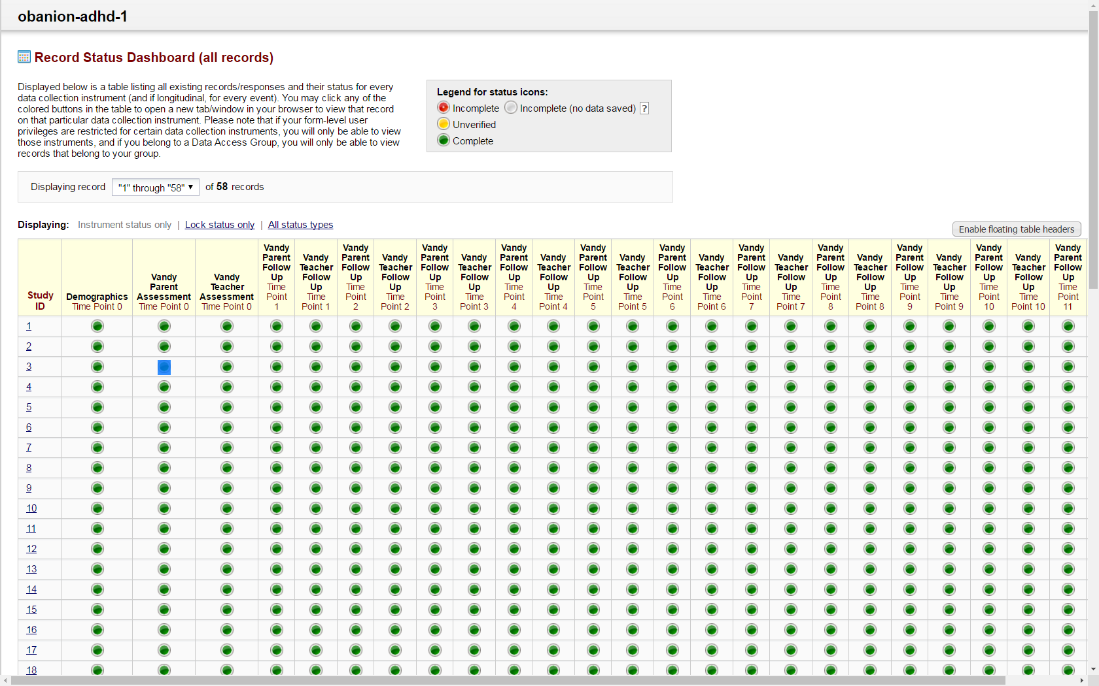

Slide 61
ADHD Project Requirements
Necessary for each investigation
IRB approval for investigation- Aug 2012
IRB approval for warehouse collaborators- Feb 2016
Teach us research goals & specifics- Feb 2016 – Mar 2016
Write code to transform warehouse into research-friendly schema.
Establish REDCap cache
Write code to transfer data from warehouse to cache
Educate researchers how REDCap & cache work
Notes:
{Go through 1-5}
5. Establish REDCap cache
* We create schema {Screenshot of REDCap project}
* Create user account
* Create API token
* Create starter script in R or SAS
For #8,
* to keep data secure once it's in the cache.
* their cache's schema relates to their research question.
* to analyze their data (if they're doing the analysis)
1. If BERD/BBMC is doing the analysis, keep the structure as reproducible as possible, while protecting PHI.
* {Screenshot of R}
* {Screenshot of GitHub}

Slide 62
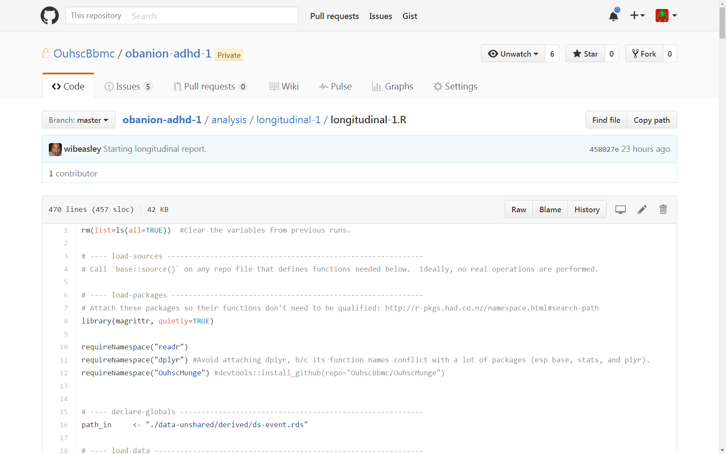

Slide 63
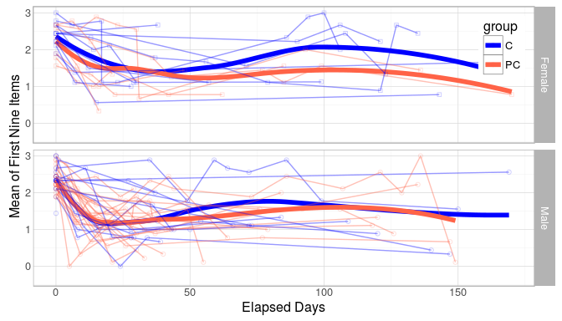

Slide 64
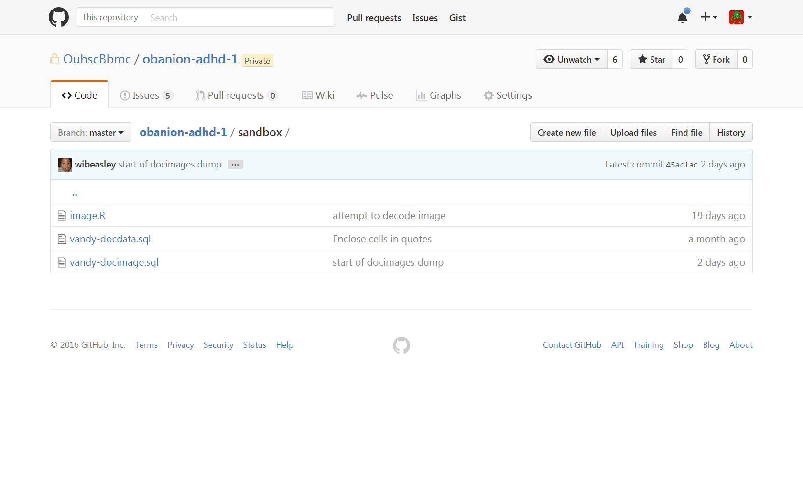
ADHD Project Challenges
Unfinished, manual EMR warehouse already existed
Had to merge old and new approaches
Some necessary EMR data stored in docdata
Required code to render docdata strings as images (.rtf and .pdf files of “quick text” and scanned documents)
Regex code required to parse analytic information from docdata images

Slide 65
ADHD Project Tasks Remaining
Merge final “quick-text” fields and scanned document data with existing database
Verify all data from EMR were recovered

Slide 66
The Future of the OUHSC CDW

Slide 67
Open to any Campus Collaborators
With the appropriate IRB approval, we’d like the system open to anyone on campus, including:
Statisticians analyzing the project caches (eg, BERD & BBMC)
Applied researchers or QA investigators (last column)
Departments adding their own data source to the ecosystem (first column)
Departments who want a separate warehouse & data sources, but want to reuse the distribution mechanism.
Notes:
we want the whole campus to benefit, and we're not possessive or worried we'll run out of work.

Slide 68
Possible Service Tiers
Tier 0: Education (free & composed of fake data)
Tier 1: Dept Cookie-cutter (free)
Tier 2: 3D box (hourly fee)
Tier 3: Multilevel (retainer + hourly fee)
Notes:
Here’s how we plan to provide a cheap or free product to those with simple needs, while still recovering costs to make the system possible. I’d like two free tiers: the 0 lacks PHI, while #1 has basic info that’s frequently used by a department (such as patient counts, or wait times). The last two tiers will accommodate more complicated research. This only applies to delivering the groomed data to the investigator.
Services like statistical analysis are considered separate. The BBMC has statisticians available for consulting, but it's not tightly bundled with the warehouse services. We want you to be free to analyze your own study, or include other statistical support groups (eg, BERD and RDAC).

Slide 69
New Features Wishlist
Scalability
More projects
More data per project
More frequent updates per project
Federal reporting benefits of combining data sources
i2b2 possible (https://www.i2b2.org/)
Learn from/with other institutions (via the Greater Plains Collaborative- http://www.gpcnetwork.org/)
Cheaper code development & maintenance.

Slide 70
Long-term Vision

Slide 71
Immediate Next Steps
Finalize roster and convene the CDW governance body
Develop standard operating procedures for CDW access and use
Determine regulatory review processes for CDW projects
Obtain data sharing agreements with other EHR systems
Round out final tweaks to existing pilot projects
Continually collect and monitor feedback from end-users and adapt system accordingly
Invite and select new CDW projects

Slide 72
OUHSC CDW Data Possibilities
Currently available
Centricity data from OKC-HSC clinics
Patient demographics
Visit information
Biometrics
Diagnoses
Lab results
Prescription information
Limited billing information
Planned additions in near future (negotiations pending)
Meditech data
CribNotes data (neonatal/perinatal specific EMR)
Select OSIIS data from OK State Dept of Health
HSC Pharmaceutical data
IDX billing information

Slide 73
Not the Only CDW in Town/State
Coming Soon: OSDH Health-e-Oklahoma system
Orion Health vendor
OPSR Data Systems & Coordination workgroup
http://smartstartok.org/opsr
OU Centricity maintains a business operations warehouse
MediTech participates in pooled warehouse
Health Information Exchanges (HIEs)
MyHealth Access Network
Coordinated Care Oklahoma
OSU Center for Health Systems Innovation pays for Cerner HIE

Slide 74
Misc
Design benefits
For the subspecialties, a wider collection/net starts to escape limitation of case-control-like designs
Advantages of starting small, compared to MyHealthNet
Pitfalls of relying on standardization that exists in those biggies
NOT missing context of a standardized tag
Not a black box. We'll share the code that took the data from datasource to project cache
Notes:
Context (were they fasting before the blood test)?
Sampling (who didn't the measure -eg, Fields)

Slide 75

Current Collaborators
Design and Management Team
Will Beasley (BBMC)
David Bard (BBMC)
Zsolt Nagykaldi (HSC FPM)
Sreeharsha Mandem (BBMC & OU CS)
Sabrina Antry (BBMC)
Geneva Marshall (BBMC)
Centricity Support
Kevin Elledge
Cynthia Proctor
Adam McGann
June Pearson
Institutional Support & Guidance
Judith James (OSCTR)
Tim VanWagoner (OSCTR)
Joel Guthridge (OSCTR)
Robert Roswell (COM)
Darrin Akins (COM)
OU IT
Mark Ferguson
Scott DeWitt
Cliff Mack
Tony Miller
Randy Moore
April Lee

